Slide 1

Uni
By: Iris Grabov
Iris.grabov12@gmail.com

Slide 2
Introducing "Uni" -united
Uni is a revolutionary app that combines the best elements of social networks and traditional dating apps, designed to keep you active, engaged, and in control of your connections.
How Uni Works:
Get Exposure by Being Active
In Uni, there are no followers, and no one gets special treatment.
The only way to be seen by others is to stay active—post something on the homepage!
Every post you share automatically gets featured on the app's homepage, giving you maximum exposure to everyone using the app.
Connect Through Interaction
Users can interact with your posts by liking them, creating meaningful engagement.
You cant see how likes your posts- This creates interest and curiosity.
The "I Want to Know" Button
If you're interested in someone, click the "I Want to Know" button on their profile.
But here's the twist: no one knows you clicked unless they click on you too!
Only if both users click "I Want to Know" will a chat open, letting you start your conversation on equal footing.
Server components -login, image upload, data management in Firebase, my application will include information sharing between its users.

Slide 3
Why Uni is Different !?
No Followers or Popularity Contest: Everyone is equal here. Your activity determines your exposure.
Focus on Effort: The app rewards users who are genuine, active, and willing to put themselves out there.
Privacy Meets Excitement: Mutual interest is key—no pressure, no awkwardness, no unnecessary notifications.
Social + Dating in One: Uni feels like a social network where you can share posts, interact, and connect in a fresh, exciting way.
With Uni, you're not just swiping mindlessly—you’re building authentic connections by sharing your thoughts, pictures, or moments. You’re making meaningful connections based on who you are and how you express yourself.
So why wait? Join Uni today—because the more active you are, the more you'll be seen, and the more meaningful connections you can create!

Slide 4

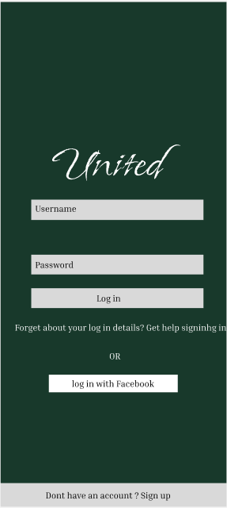
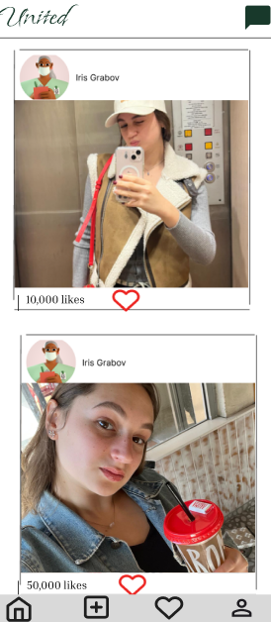
Login screens
Home page displaying content from all users in the app that applauded a picture , you can like on posts.
Chats

Slide 5
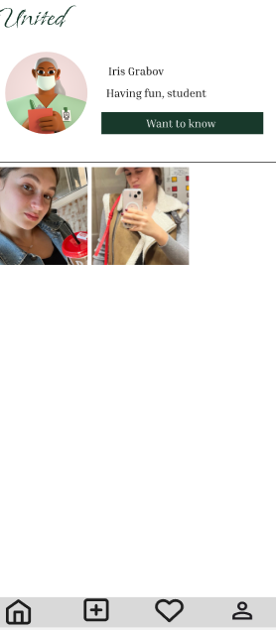
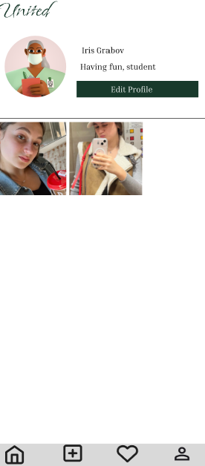
User clicks on his profile:
Other users clicks on some profile after see the post on the home screen:

Slide 6
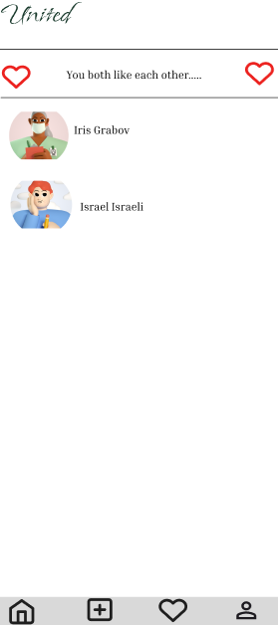
Both users clicks on “Want to know” :

Slide 7
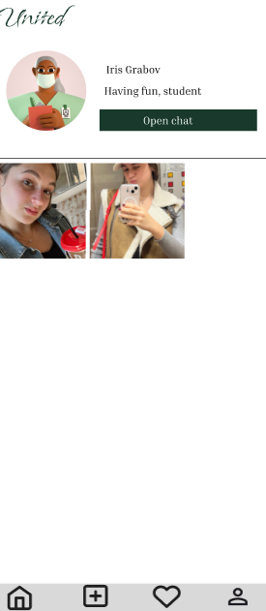
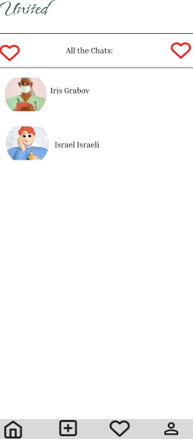
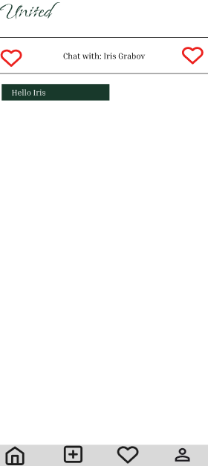
Only after the
Both users clicks on “Want to know” the chat feature is now available:

Slide 8
Hope you will enjoy my app!

